Slide 2
S.Coop.And.
SEAWEED THAT SAVES THE SHORE

Slide 3
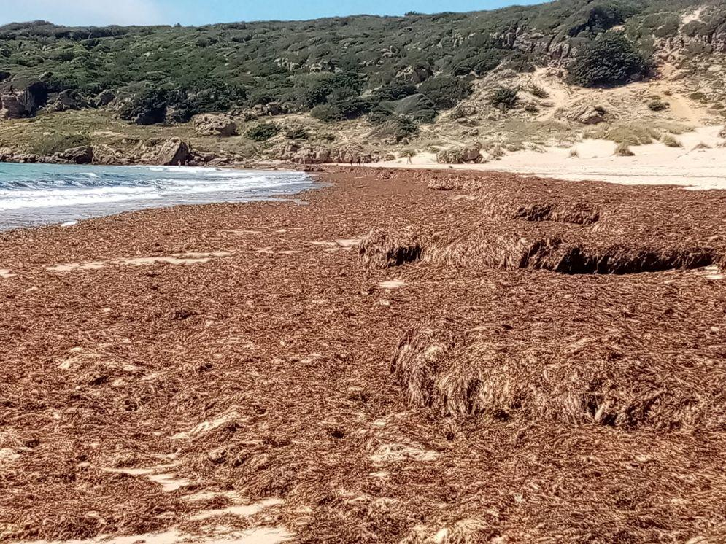
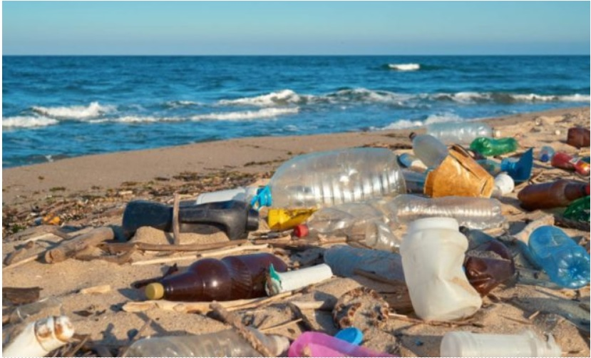
PROBLEM STATEMENT

Slide 4
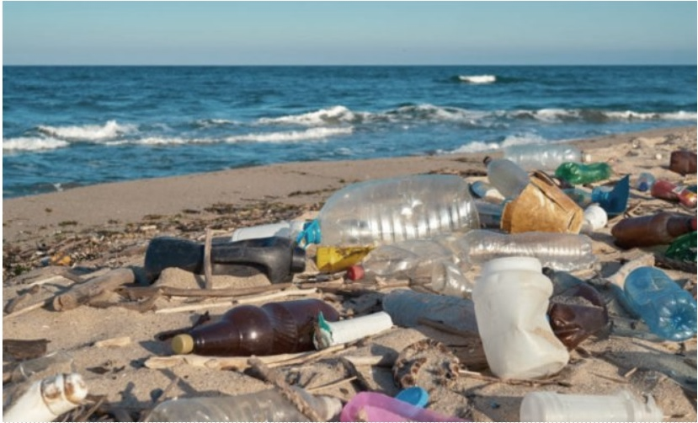
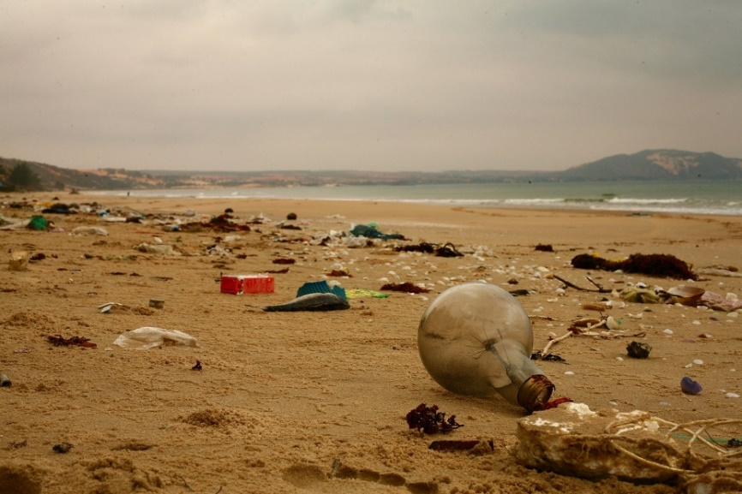
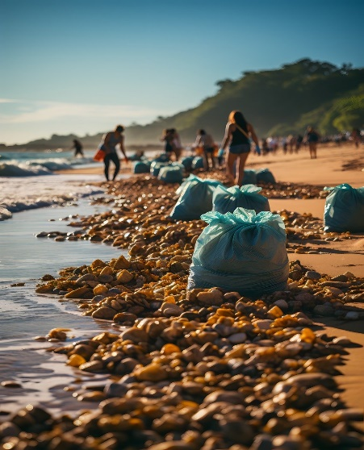
MAIN FACTORS
HIGH CONSUMPTION
POOR MANAGEMENT
LOW ENVIRONMENTAL AWARENESS
INDUSTRIES
WASTEWATER
LIFESTYLE
CURRENT TRENDS
BETTER WASTE MANAGEMENT (RECYCLING)
INCREASED ENVIRONMENTAL AWARENESS
NEW MORE SUSTAINABLE ALTERNATIVES
NEW REGULATIONS AND LAWS

Slide 5
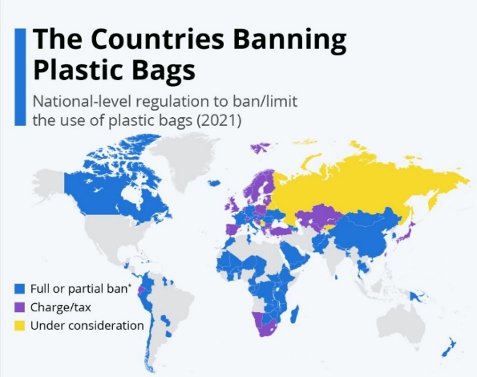
Current Global Actions
DIRECTIVES
*DIRECTIVE (EU) 2019/904 OF THE EUROPEAN PARLIAMENT AND OF THE COUNCIL OF THE EUROPEAN UNION of 5 June 2019 on the reduction of the impact of certain plastic products on the environment
NEW REGULATIONS AND LAWS
Law 3/2023, of 30 March, on the Circular Economy of Andalusia.
Law 7/2022, of 8 April, waste and contaminated soils, for a circular economy.

Slide 6
PROBLEM STATEMENT

Slide 7
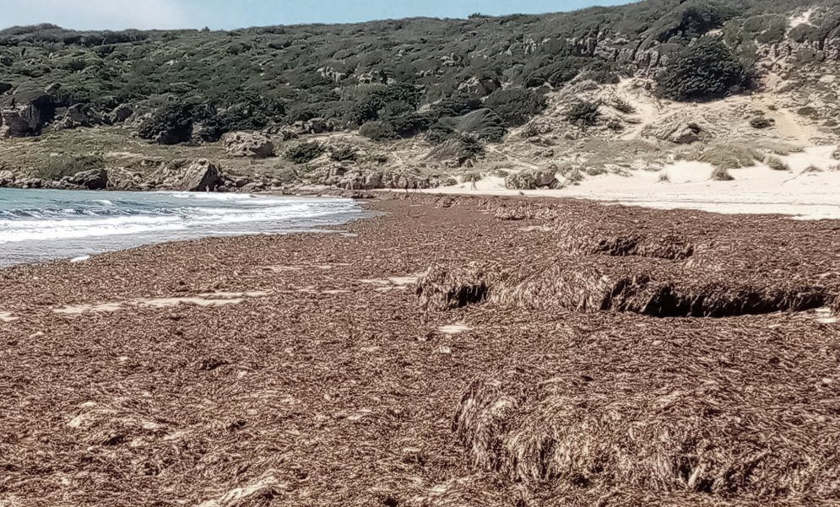
Rugulopteryx okamurae (Invasive species)

Slide 8
Rugulopteryx okamurae (Invasive species)

Slide 11
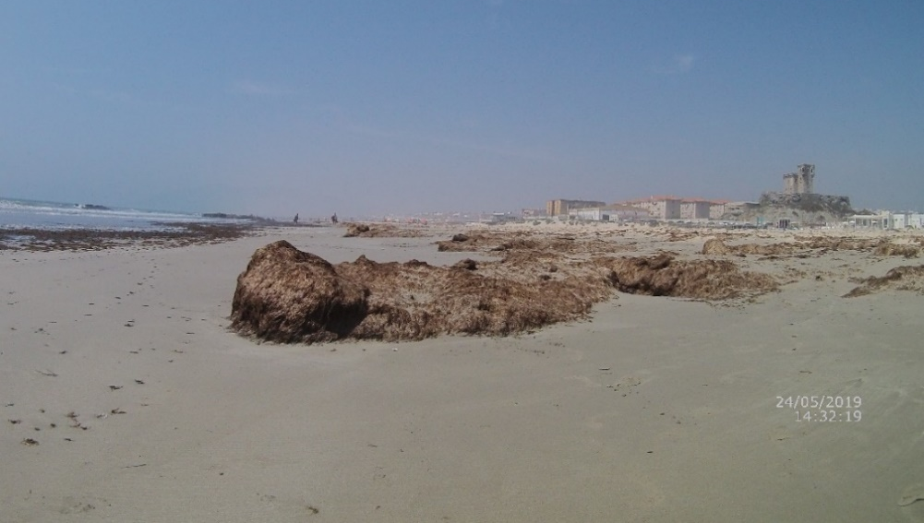
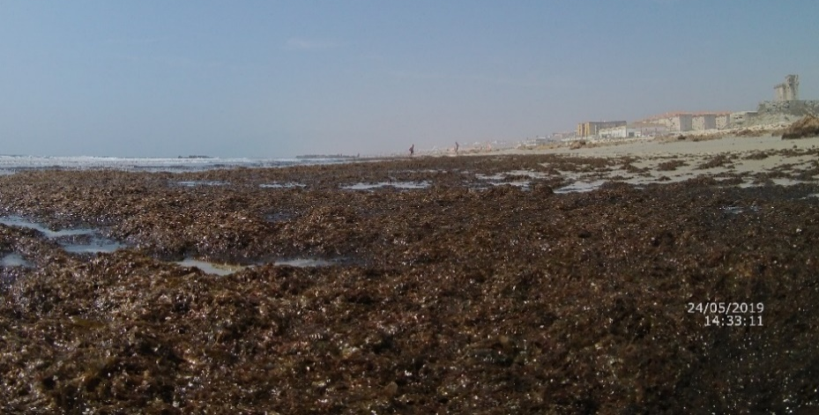
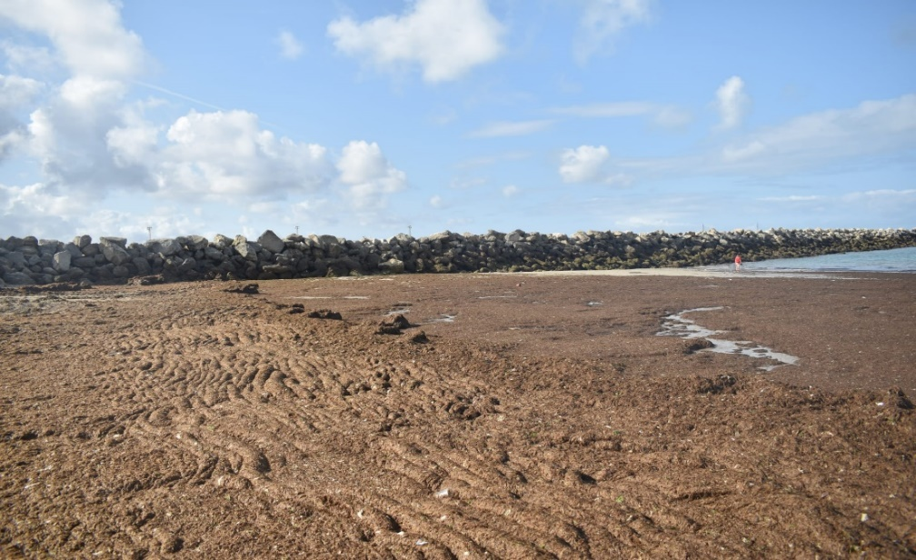
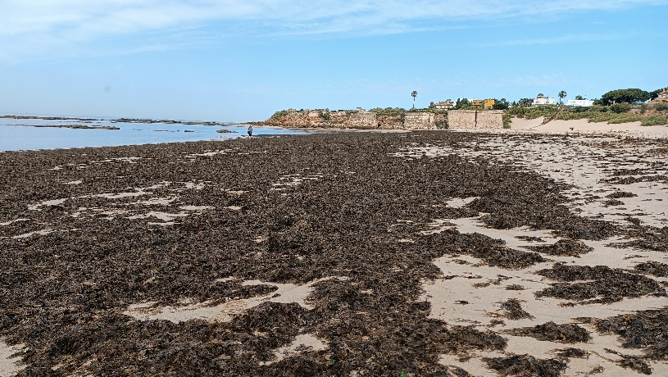
PLAYA DE LOS LANCES, TARIFA 2024
LA MURALLA (EL PUERTO DE SANTA MARÍA,2023)

Slide 12
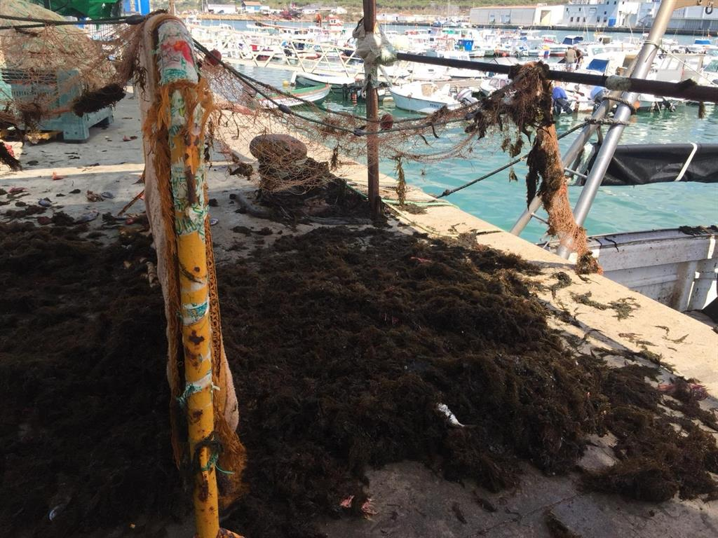
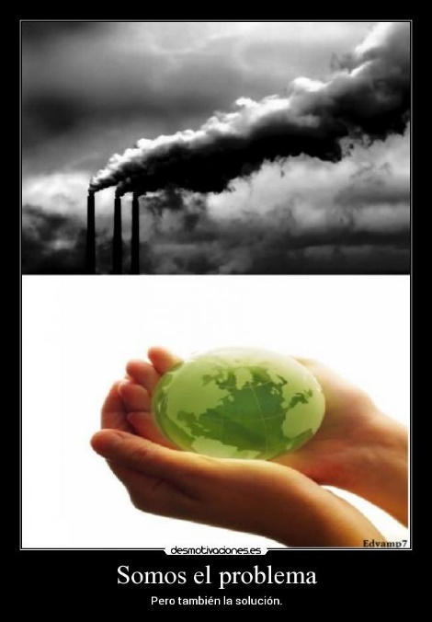
ECONOMIC IMPACT
Issues for the fishing industry
Environmental
Impact
Impact on the tourism

Slide 13
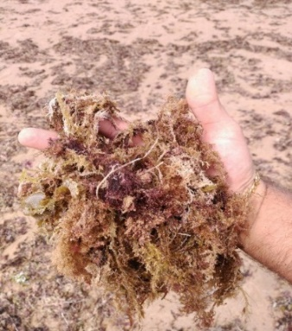
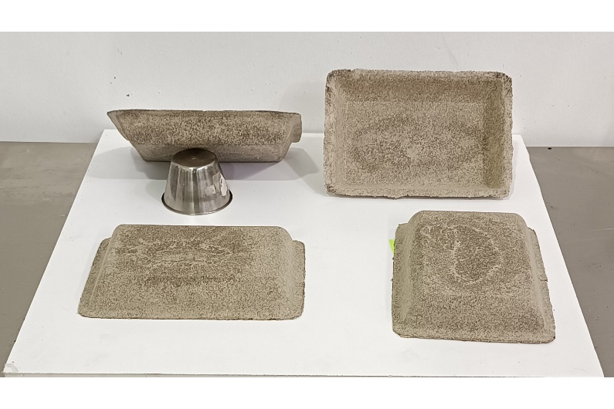
OUR SOLUTION
USE OF THE SEAWEED WASHED ASHORE (REVALORISATION)
TRANSFORMATION INTO BIODEGRADABLE AND COMPOSTABLE SEAWEED PACKAGING
WE FOCUS ON THE FRUIT AND VEGETABLE AREA, WITHOUT RULING OUT OTHER SECTORS.

Slide 14
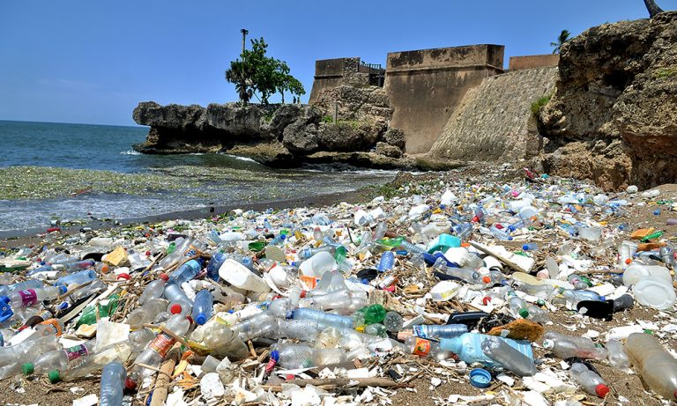
S.Coop.And
MAIN OBJECTIVES
RE-USE
RECYCLING
WASTE 0
LOW CARBON FOOTPRINT (OR NEGATIVE)
REDUCTION OF PLASTIC POLLUTION

Slide 15
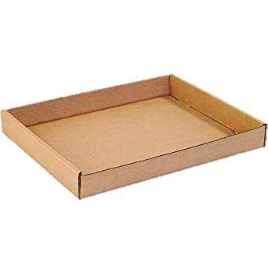
Conventional vs Futuralga
CARDBOARD, PAPER,
CELLULOSE
NEW MATERIALS
(FUTURALGA)
PLASTIC
NOT ECO-FRIENDLY
TAKES HUNDREDS OF YEARS
TO DISINTEGRATE
NATURAL
DISINTEGRATION AFTER ONE YEAR
BIODEGRADABLE
NATURAL
TAKES AFTER FOUR WEEKS
TO DISINTEGRATE
BIODEGRADABLE & COMPOSTABLE

Slide 16
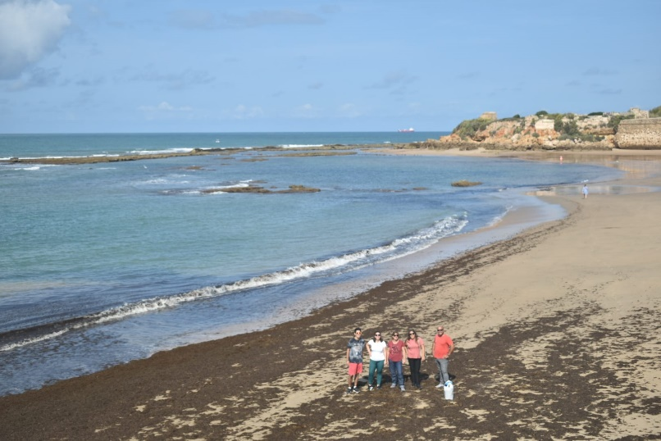
TEAM
FOUNDERS
COLABORATORS
SOFÍA TRISTANCHO RUIZ
MARINE SCIENCES (UCA)
MARINE BIOLOGY (UALG)
CEO
VÍCTOR M. PÉREZ IGNACIO
MARINE SCIENCES (UCA)
AQUACULTURE AND
FISHERIES (UCA)
COO
ELENA GARCÍA
BUSINESS ADMINISTRATION
AND MANAGEMENT (UCA)
CM
María Benítez Aleu (Biotechnology)
Belén Pina Copano (Biotechnology)
Trinidad Roldán Luque (Biotechnology)
Carlos García Macías (Marine Sciences)
Miriam Conforto (Biotechnology)
INTERNS

Slide 17
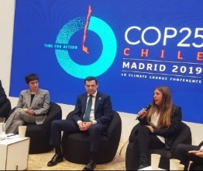
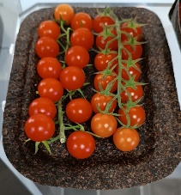
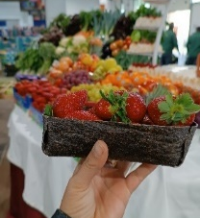
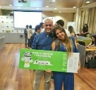
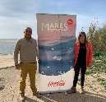
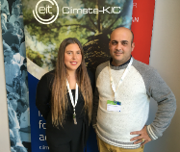
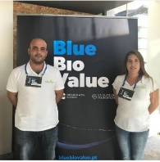
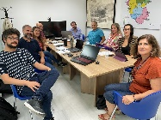
TIMELINE
2025
INTELECTUAL PROPERTY
2021
EUROPEAN GRANT
2018
2019
CLIMATE SUMMIT
(COP25) MADRID
2023
FIRST PROTOTYPES
2018-2023
NATIONAL AND INTERNATIONAL BUSINESS ACELERATOR PROGRAMS
2022
START OF THE GRANT
2023-2024
FUNCTIONAL PROTOTYPES
2019-2023
NATIONAL AND INTERNATIONAL AWARDS AND RECOGNITIONS

Slide 18
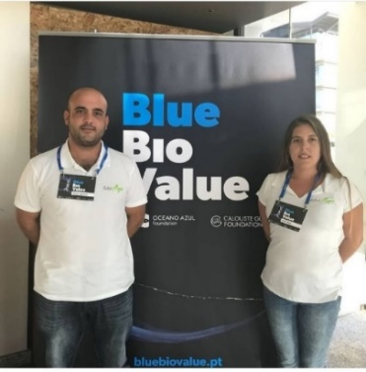
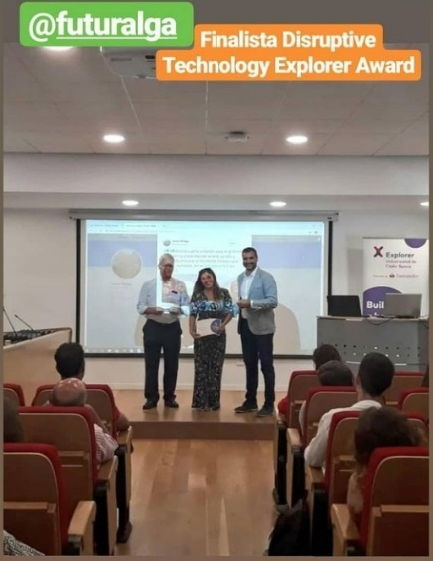
PATH
BUSINESS ACCELERATION PROGRAMS

Slide 19
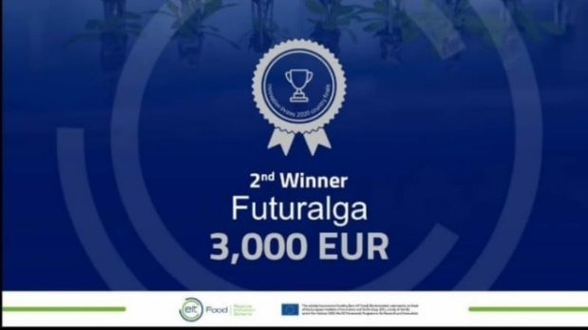
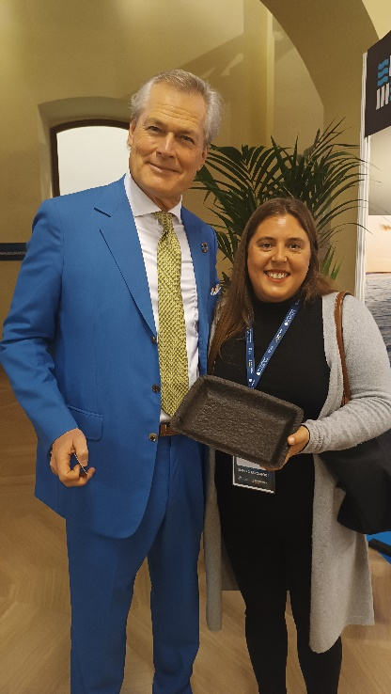
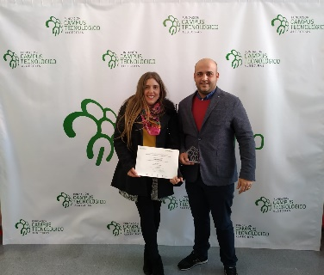
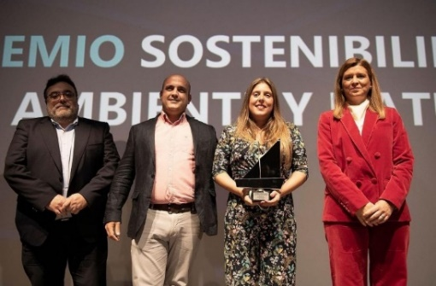
AWARDS

Slide 20
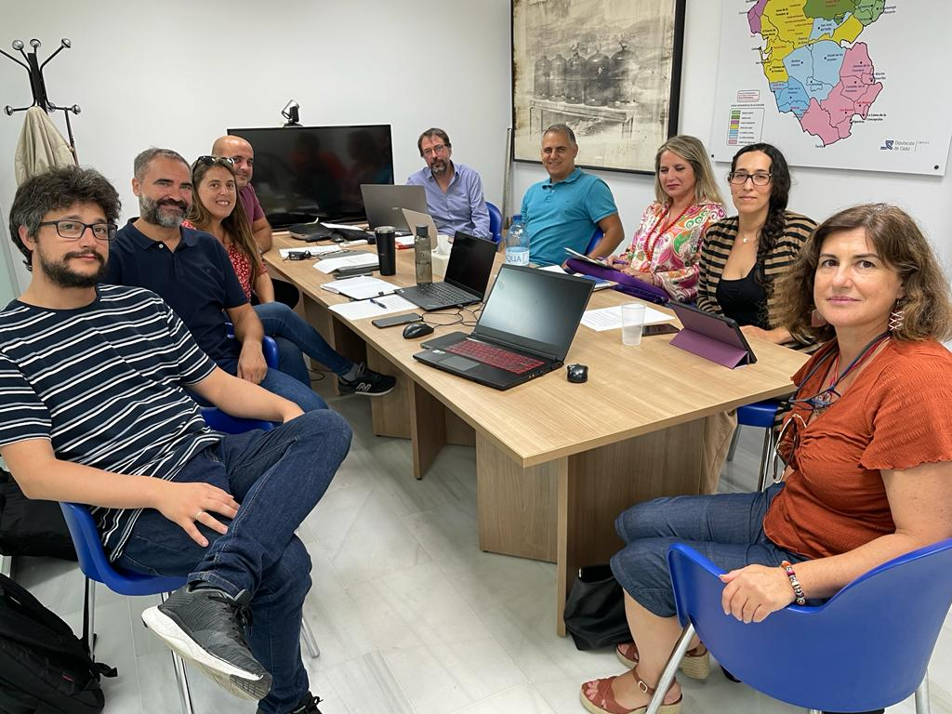
ALGAE-COPACK
GOA: AGRICULTURAL OPERATIONAL GROUP
S.Coop.And
SUPPORTED BY:
ACTIVE SEARCH FOR FUNDING
AND INVESTORS

Slide 21
LAST STEPS
16-26 NOVIEMBRE 2024
22-30 NOVIEMBRE 2024
FEBRERO 2025

Slide 22
COLLABORATORS

Slide 23
THANK YOU FOR YOUR ATTENTION
www.futuralga.com

