Slide 1

«Agriturismo Su Stai
Podere Valbella»
The agricultural cooperative "Strovina 78" was founded in 1978 thanks to the efforts of a group of young farmers who, after years of hard work, managed to bring the uncultivated lands of the ancient "Vittorio Emanuele" estate back into production. The company is located in Sanluri Stato, a rural district of Sanluri, situated in the heart of the Campidano, between Cagliari and Oristano.

Slide 2
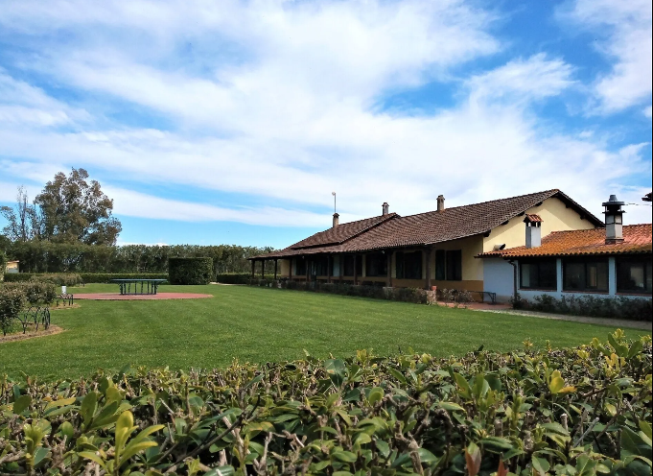

Slide 3
Biodiversity of the Food Community is our main focus:
Our cooperative is working to defend and promote biodiversity in food production.
We are preserving diverse legumes: "Fava Sarda" from Sanluri, chickpeas, and lentils from Marmilla.
We are registered in the Regional Register of Custodian Breeders of the Sardinian Pig which give us the possibility to use it for the processing of Sardinian pig meat to make ham.
Our cooperative has been breeding the Sardinian donkey breed, which is at risk of extinction, for several years, (source FAO)
Many of this product are used in our agritourism, where we serve in our menus in order to enhance our biodiversity’s product and share with our customer.

Slide 4
Conservation of Indigenous Varieties:
We are preserving various indigenous grapevine varieties for wine production.- We also conserve multiple varieties of local fruits.
The orchard includes a selection of ancient fruit varieties from Sardinia, particularly plum, apple, pear, and apricot. Our vineyard consists of a selection of wine and table grapevines from clones of ancient grape varieties native to Sardinia.
Many of this quality type of fruit were not used anymore. With our research and work we were able to reuse and diffuse again this variety.

Slide 5
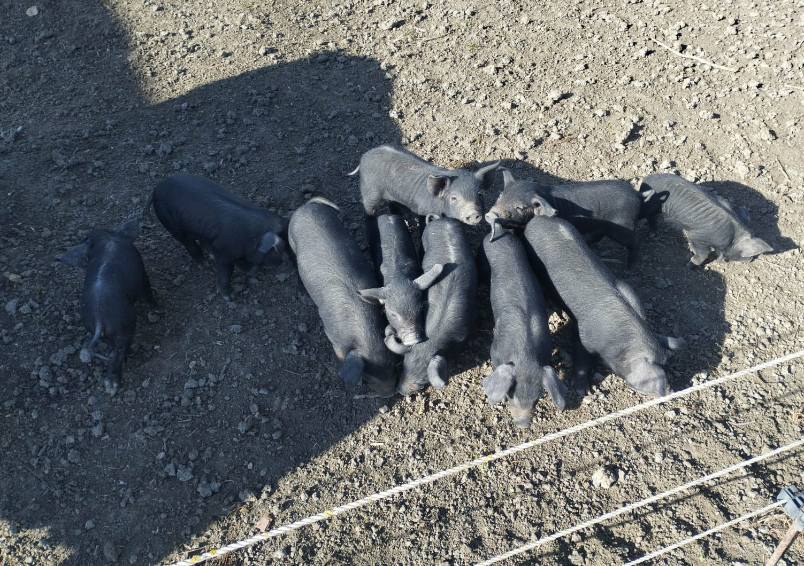
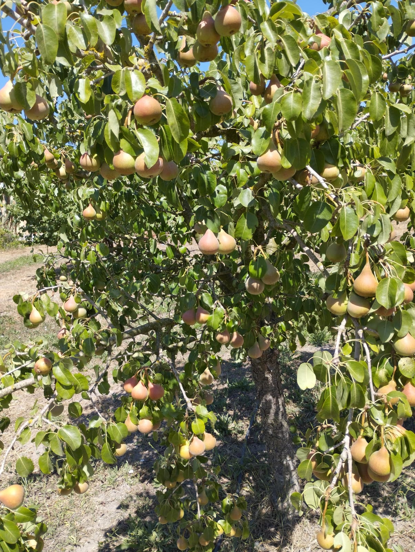
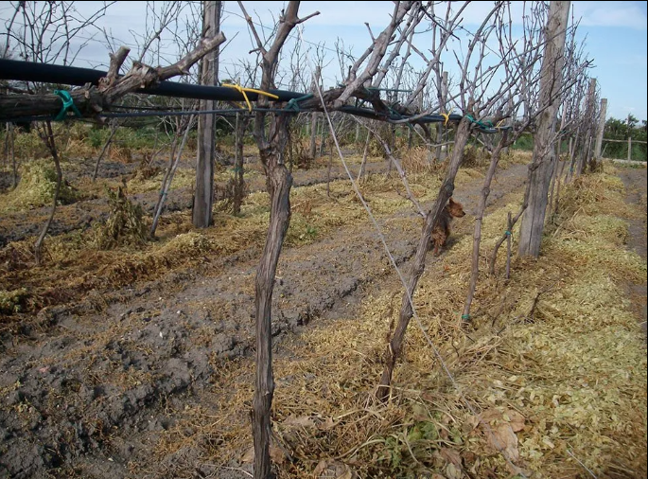

Slide 6
Introducing "Incomunis"-
"Incomunis" is a community dedicated to protecting agro-biodiversity and food in southwestern Sardinia.- Legal references: Regional Law n.16/2014 and National Law n.194/2015
The Importance of "Incomunis" Community: - The community is a key tool to safeguard, conserve, and promote the agro-biodiversity of southwestern Sardinia.- It focuses on all aspects of food: historical, cultural, identity, economic, environmental, social, and sustainability.

Slide 7
Growing Participation and School Initiatives
By March 2025, approximately 85 participants have joined the community: custodians, farmers, universities, local action groups, provinces, municipalities, and committees for biodiversity protection.
Noteworthy is the involvement of school canteens offering local, plant-based menus, contributing to food education and reducing waste.

Slide 8
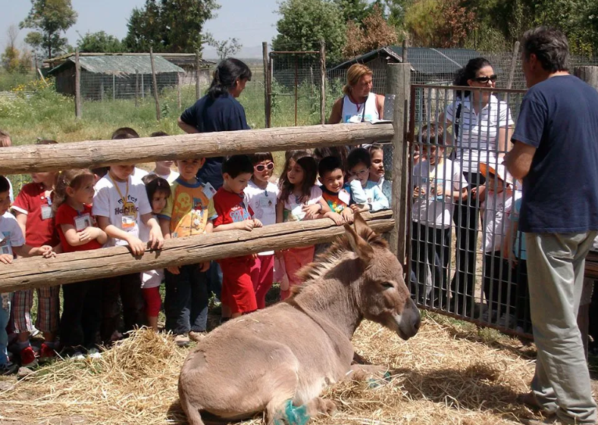
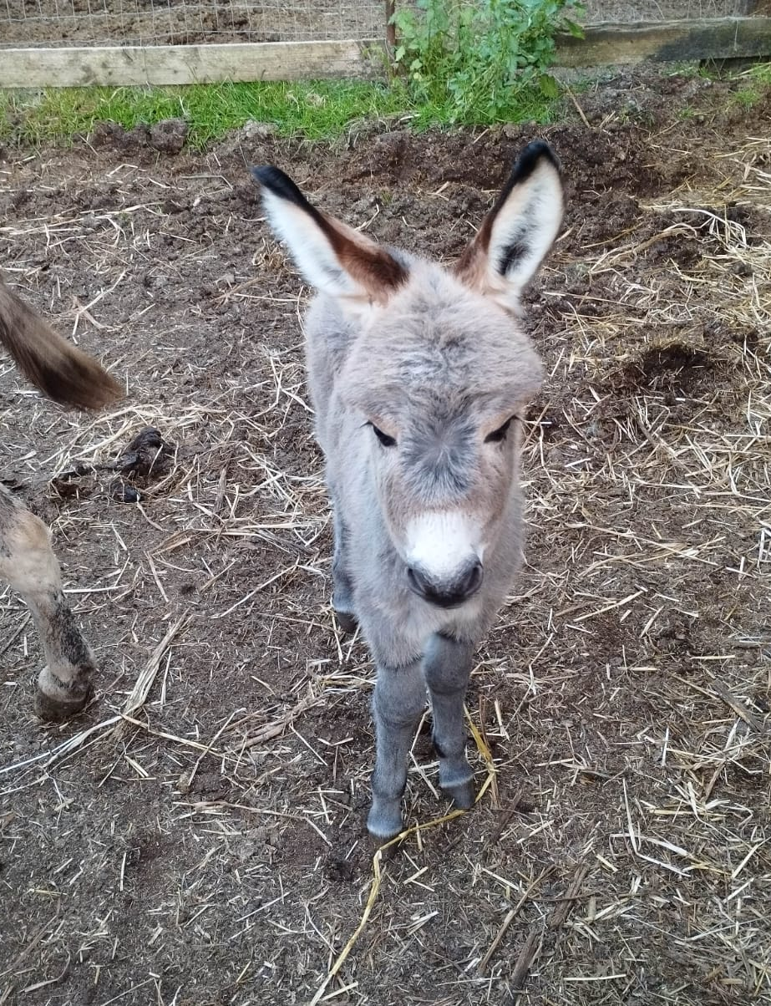

Slide 9
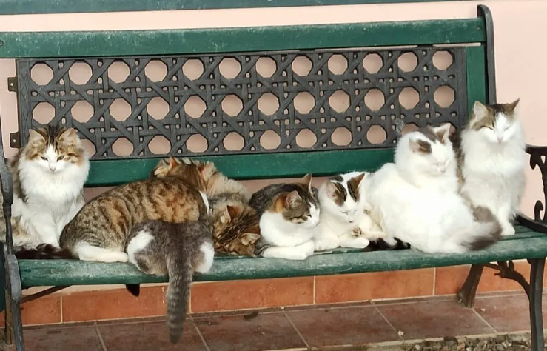
Thank you for you attention

