Slide 1




CUIB
The zero waste bistro –
from vision to practice
Eco packaging and unpacking
Anca Gheorghică, PhD
27.11.2024

Slide 2


Who am I?
🦋 Mother
🍃 Resilient @mai.bine
💚 Green social entrepreneur
@c.u.i.b & @redu.org.ro
🏵️ Altereco @intru.in.fire
🌏 Human ecologist
🌍 Degrowther

Slide 3

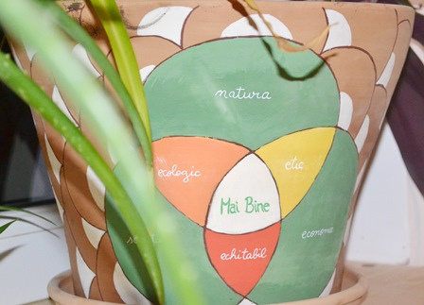
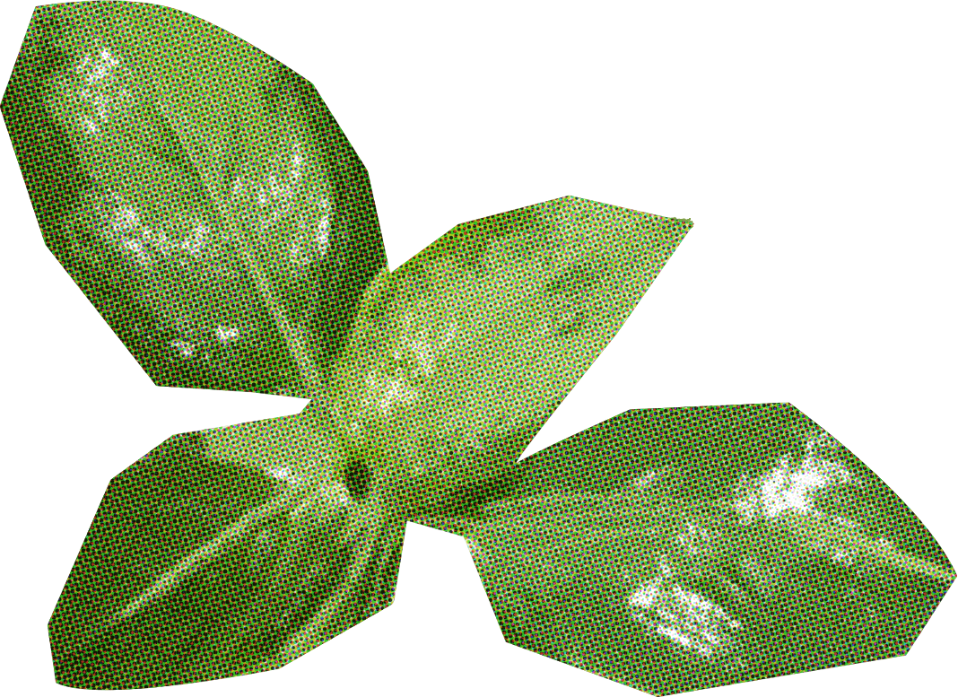

Slide 4



Vision: A better world - ecologically sustainable, socially equitable, governed by sound ethical rules and principles.
Areas of action:
Ecology and environmental protection
Education for sustainable development
Social economy / Eco-entrepreneurship
Civic engagement
Research and innovation in sustainability
Action approach: holistic, in the sphere of human ecology
Action conductive wire: responsible consumption and production

Slide 5
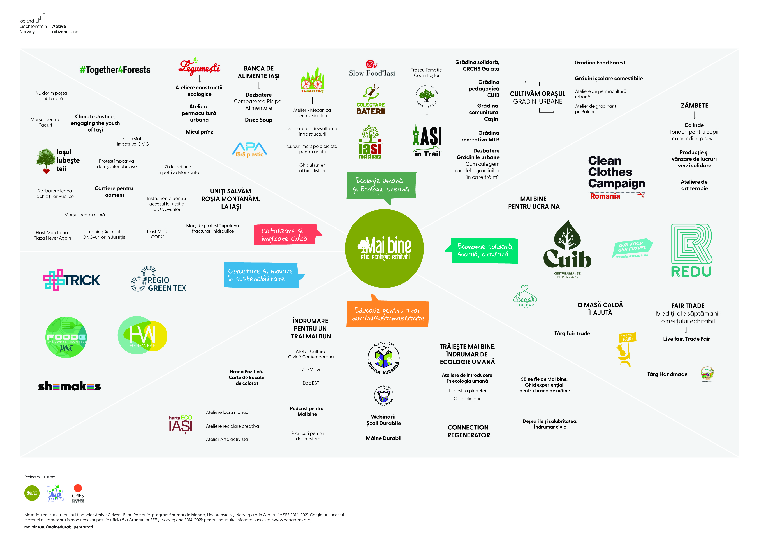
Notes:
A recent infografic on the projectsand initiatives that we implemented or in which we were involved in our 15 years of experience – hard to decide only on one, I chose two – the most importan, the permanent projects of Mai bine

Slide 6
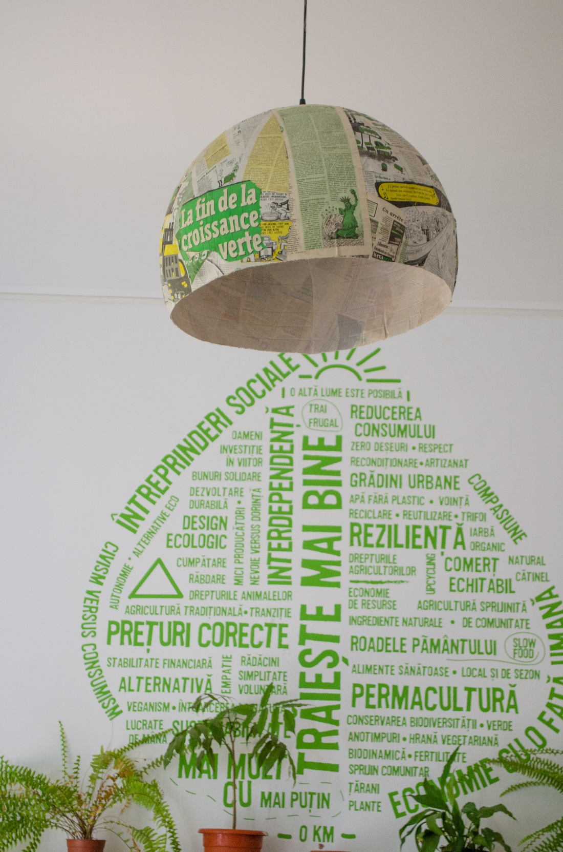
CUIB –
probably the most sustainable bistro in Romania
A green social enterprise founded in 2013, 100 % owned by Mai bine

Slide 7
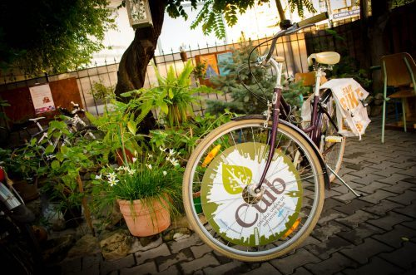
CUIB -
Urban Centre for Good Initiatives
- a space for sustainable food consumption for increasing positive social impacts on the community and reducing negative environmental impacts

Slide 8
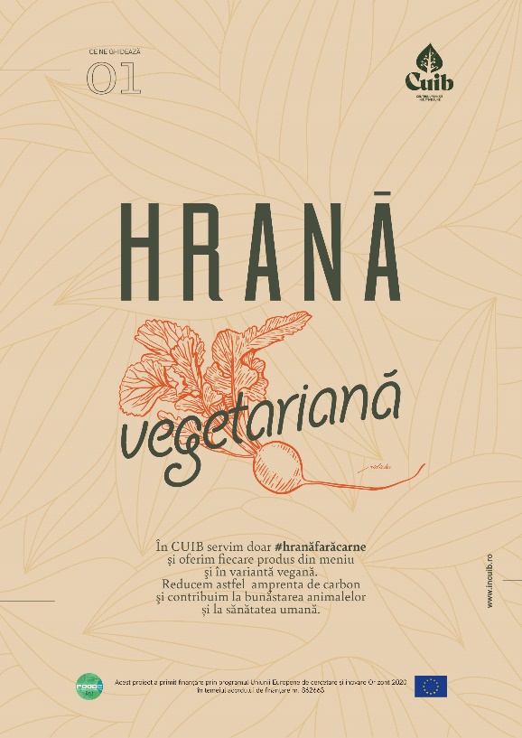


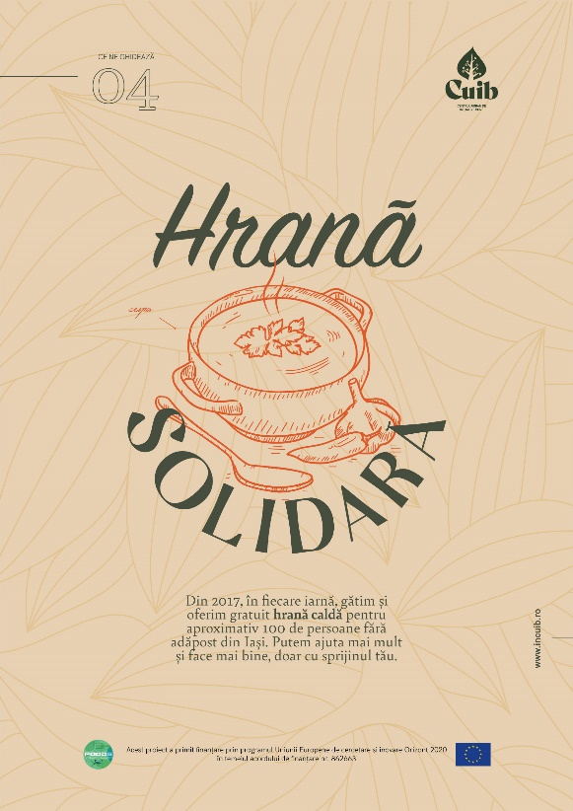



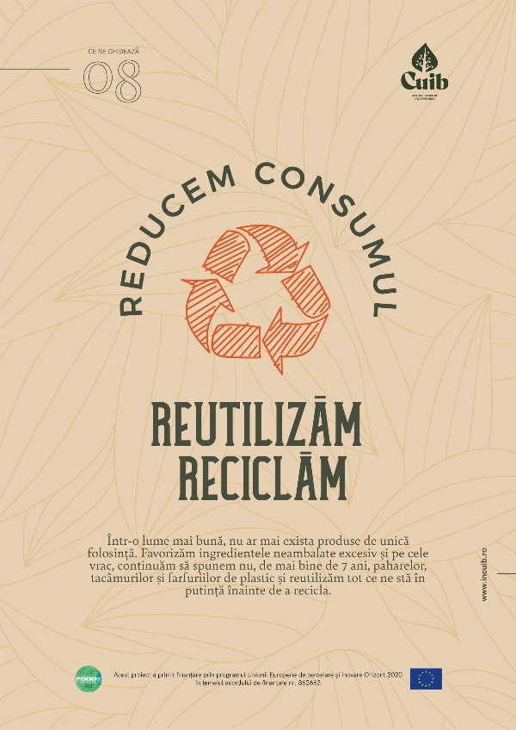

‘s Principles

Slide 9
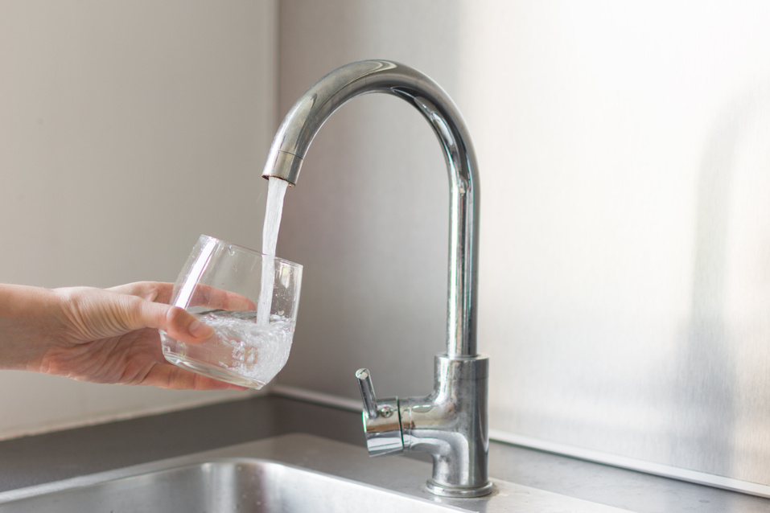
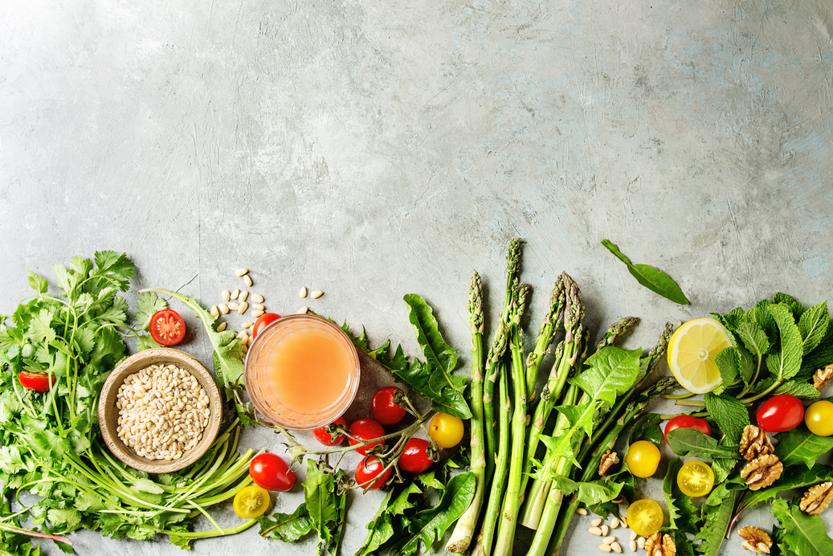
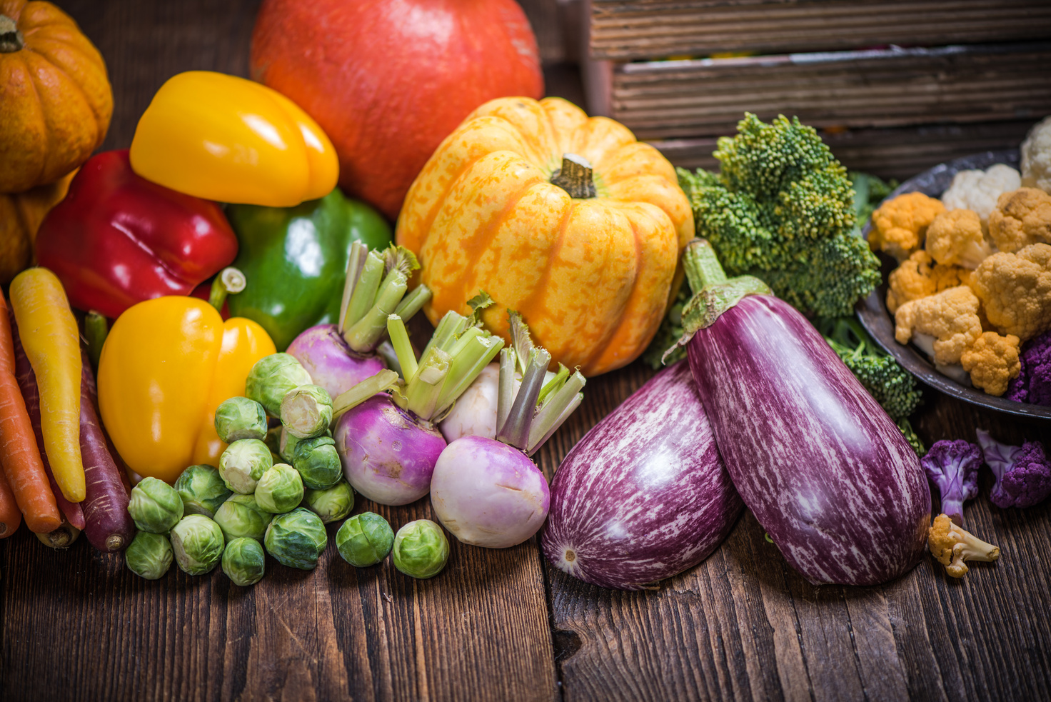
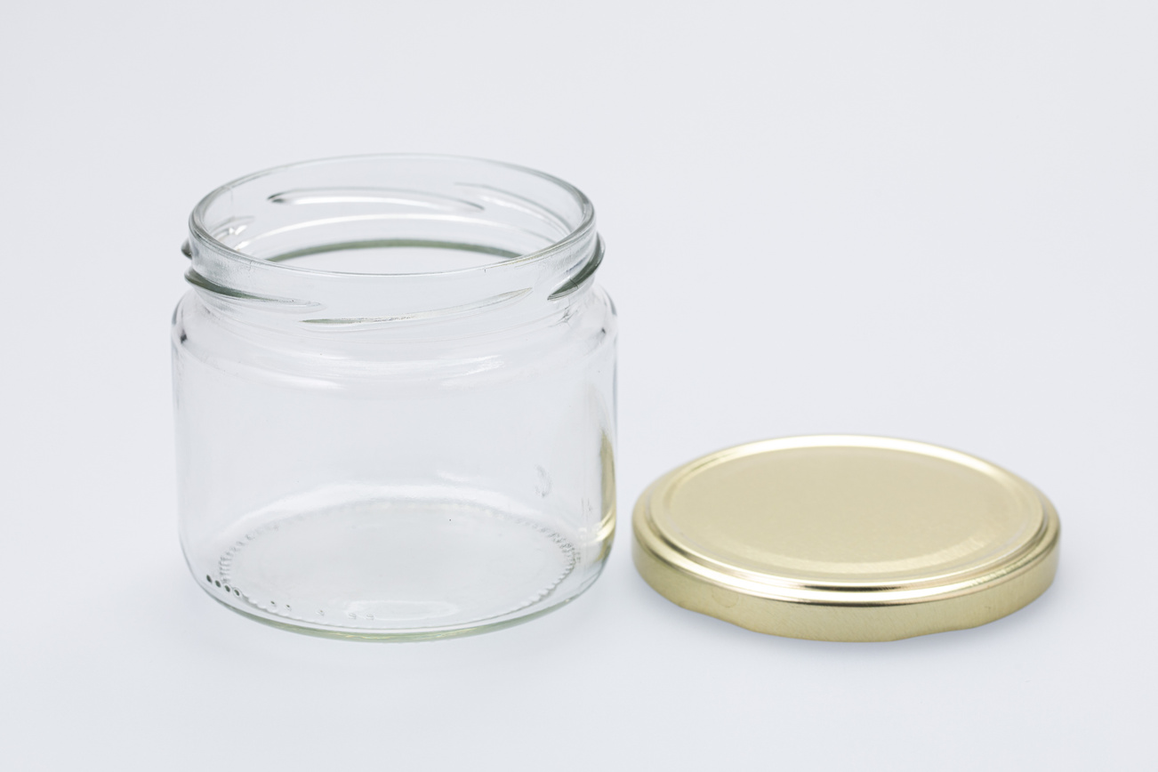

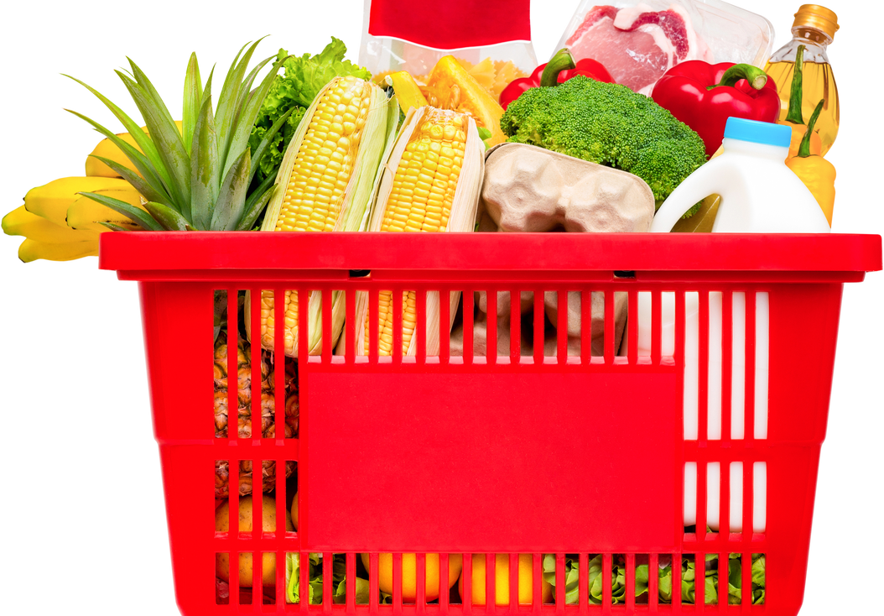
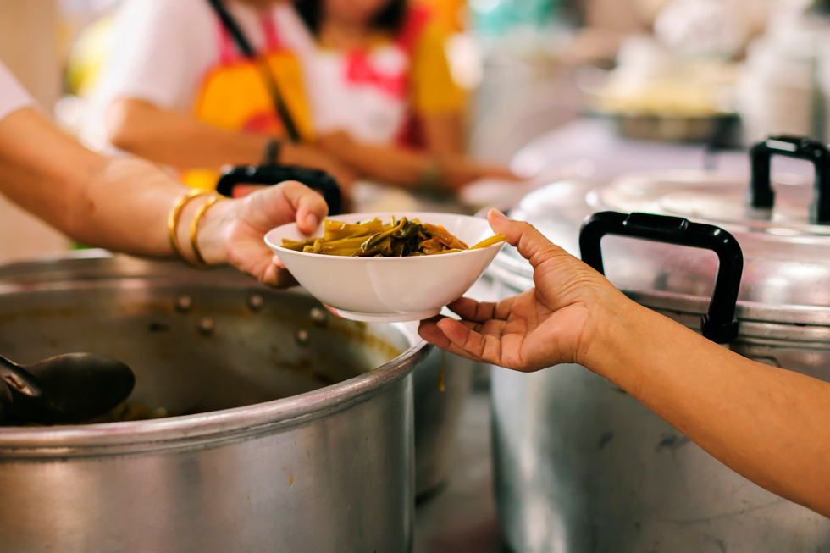
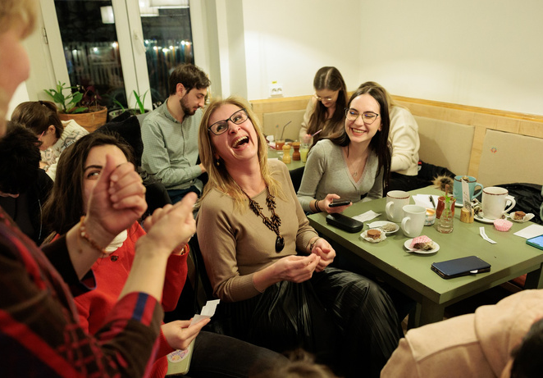
‘s Actions
Free water for all
Vegetarian food
KM 0 - Local & seasonal ingredients
Zero waste delivery & catering
Fair trade products
Rescued ingredients
Free meals for refugees & homeless locals
Educative and social events

Slide 10
CUIB –
towards zero impact
Almost
Zero
waste
Almost
Zero
Food waste
Almost
Zero
KM

Slide 11
Reducing/ Combating food waste
External waste:
integrating recovered ingredients into the menu
Recovere food donated to the vulnerable people
Over 30 tons of recovered food
Internal waste:
"what you have" based on recipes - versatile, easily adaptable menu,
food preservation recipes: drying, dehydration, fermentation, etc.

Slide 12
Circular economy model for HORECA
Aspiration – A Closed Loop Production Model
Composting of food waste - earth farm - growing aromatic herbs in our small urban gardens – using the herbs in our dishes

Slide 13
Reducing/
Combating waste
Refuse
Reduce
Recover
Reuse
Repair
Refurbish
Rot
Recycle

Slide 14
Reducing/ Combating waste
Eco packing and Unpacking
Water without plastic – free water for everyone
Bulk ingredients
Packaging for delivery in reusable baking paper and reusable jars
No single use cuttlery
Coffe to go in reusable cups/ jars
Reductions for custumers coming with own recipients

Slide 15
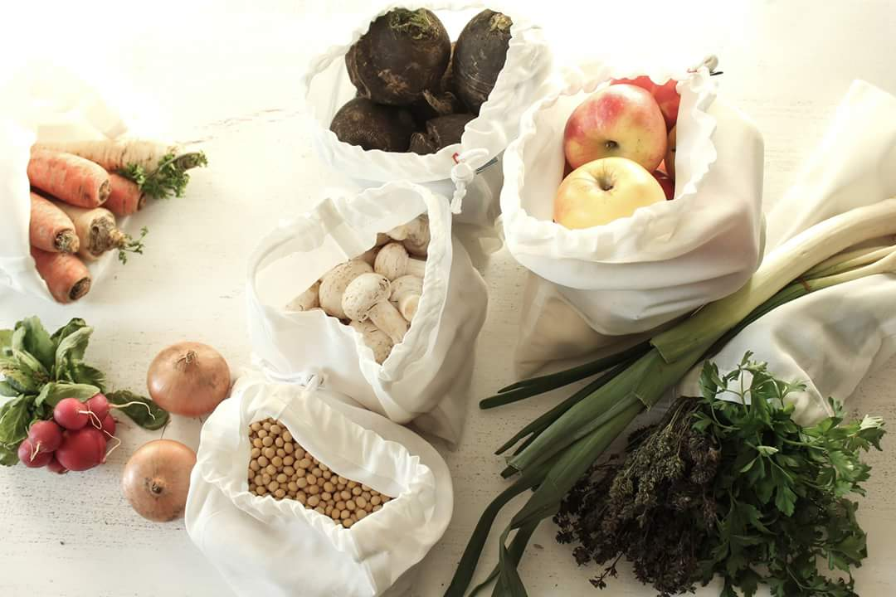
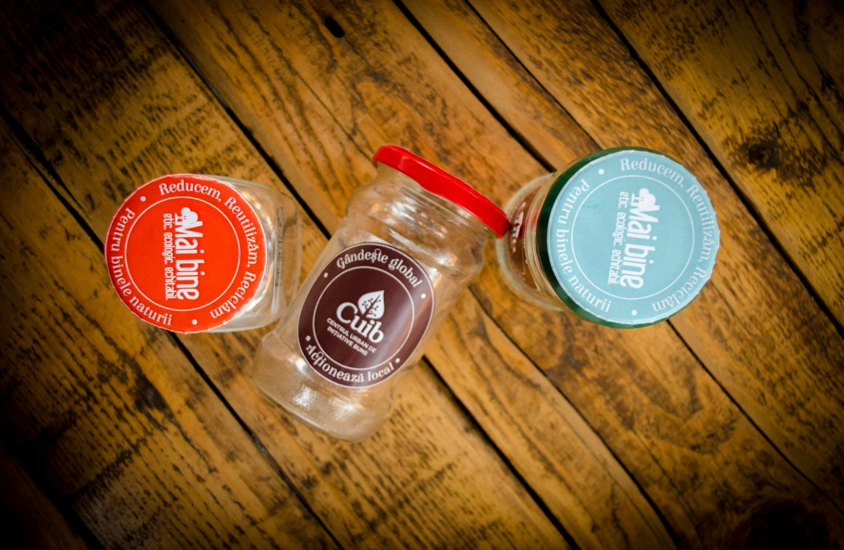
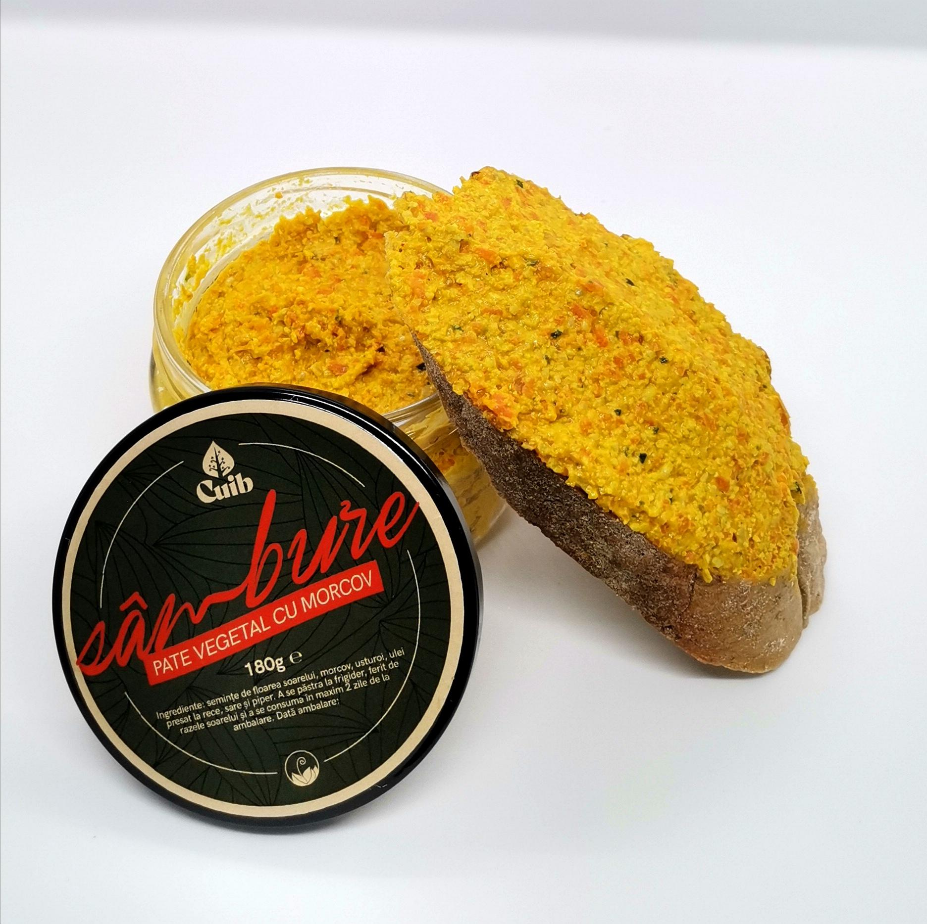
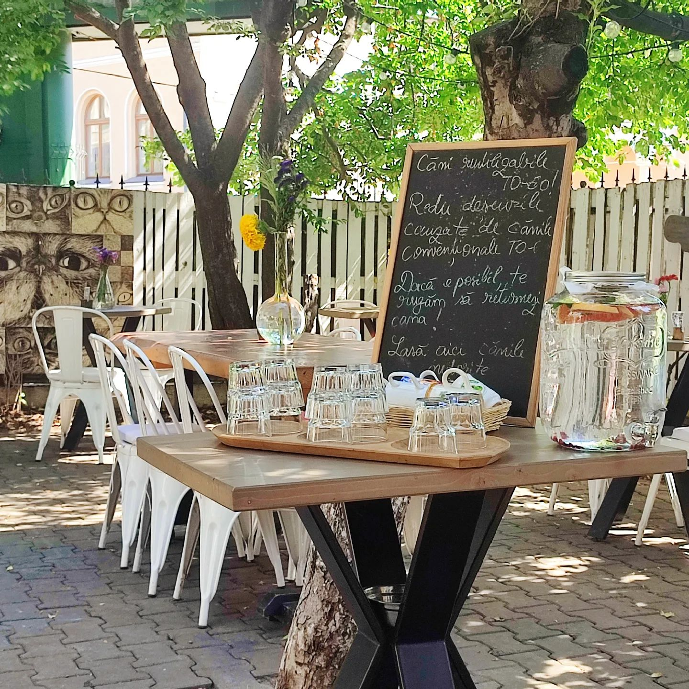
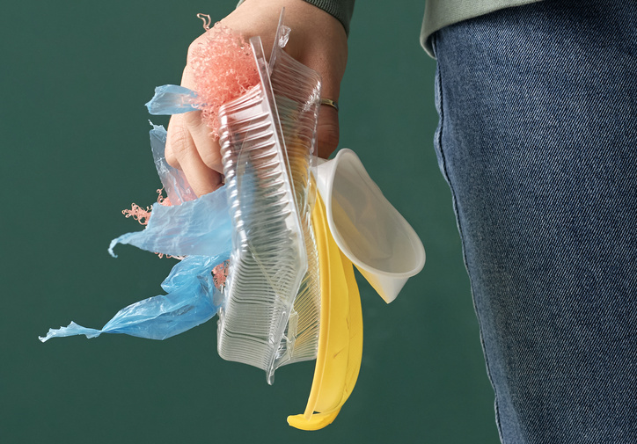
Eco packaging and unpacking @
‘s Principles
Free water for all
Vegetarian food
KM 0 - Local & seasonal ingredients
Zero waste delivery & catering
fair trade products
rescued ingredients
free meals for refugees & homeless locals
educative and social events

Slide 16
‘s Impact on waste reduction
,
Water without plastic:
214 500 litres of water
11 583 kg of petrol
8 580 Kg CO2
Zero waste practices:
over 111 850 packages
over 250 000 single use products
Food waste reduction?
+30 000 kg

Slide 17
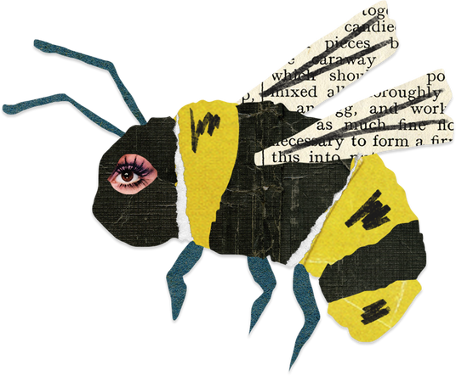
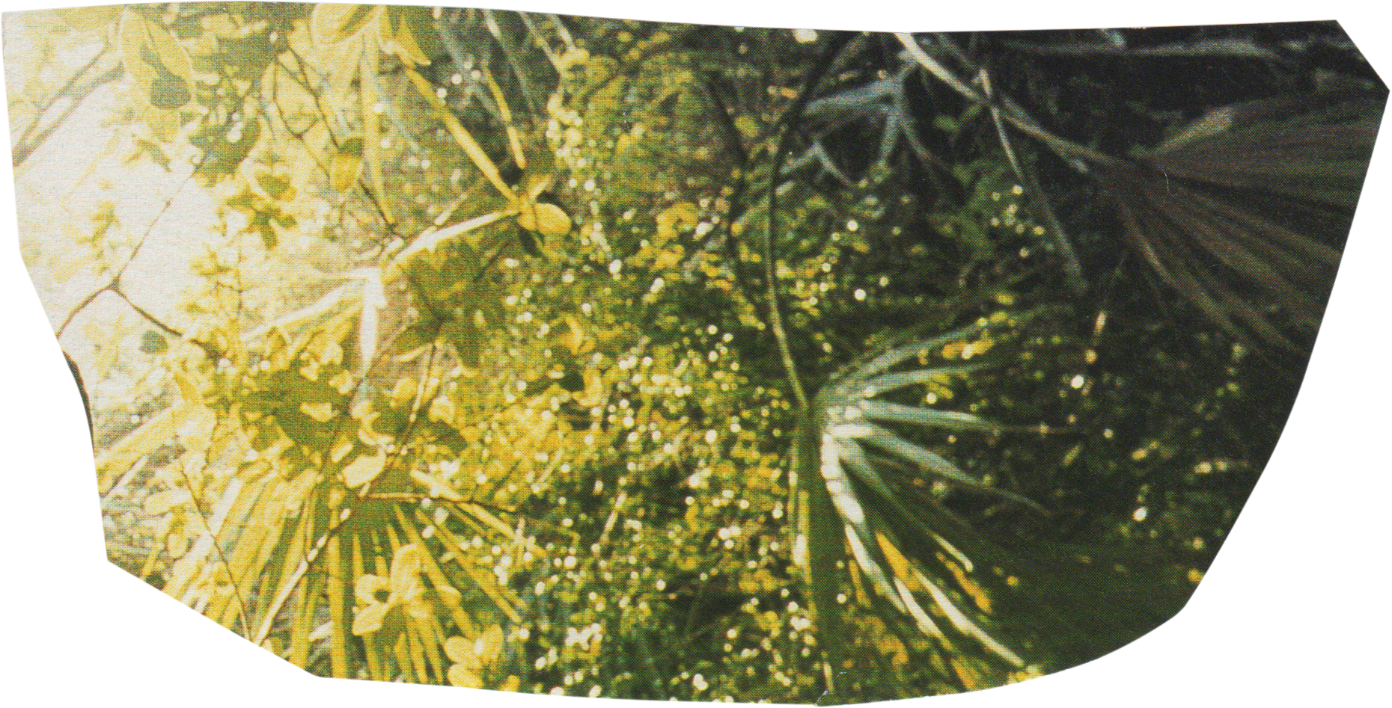
There, Master Niketas,’ Baudolino said, ‘when I was not prey to the temptations of this world, I devoted my nights to imagining other worlds. A bit with the help of wine, and a bit with that of the green honey. There is nothing better than imagining other worlds,’ he said, ‘to forget the painful one we live in. At least so I thought then. I hadn’t yet realized that, imagining other worlds, you end up changing this one.
Umberto Eco
Thank you!

Slide 18


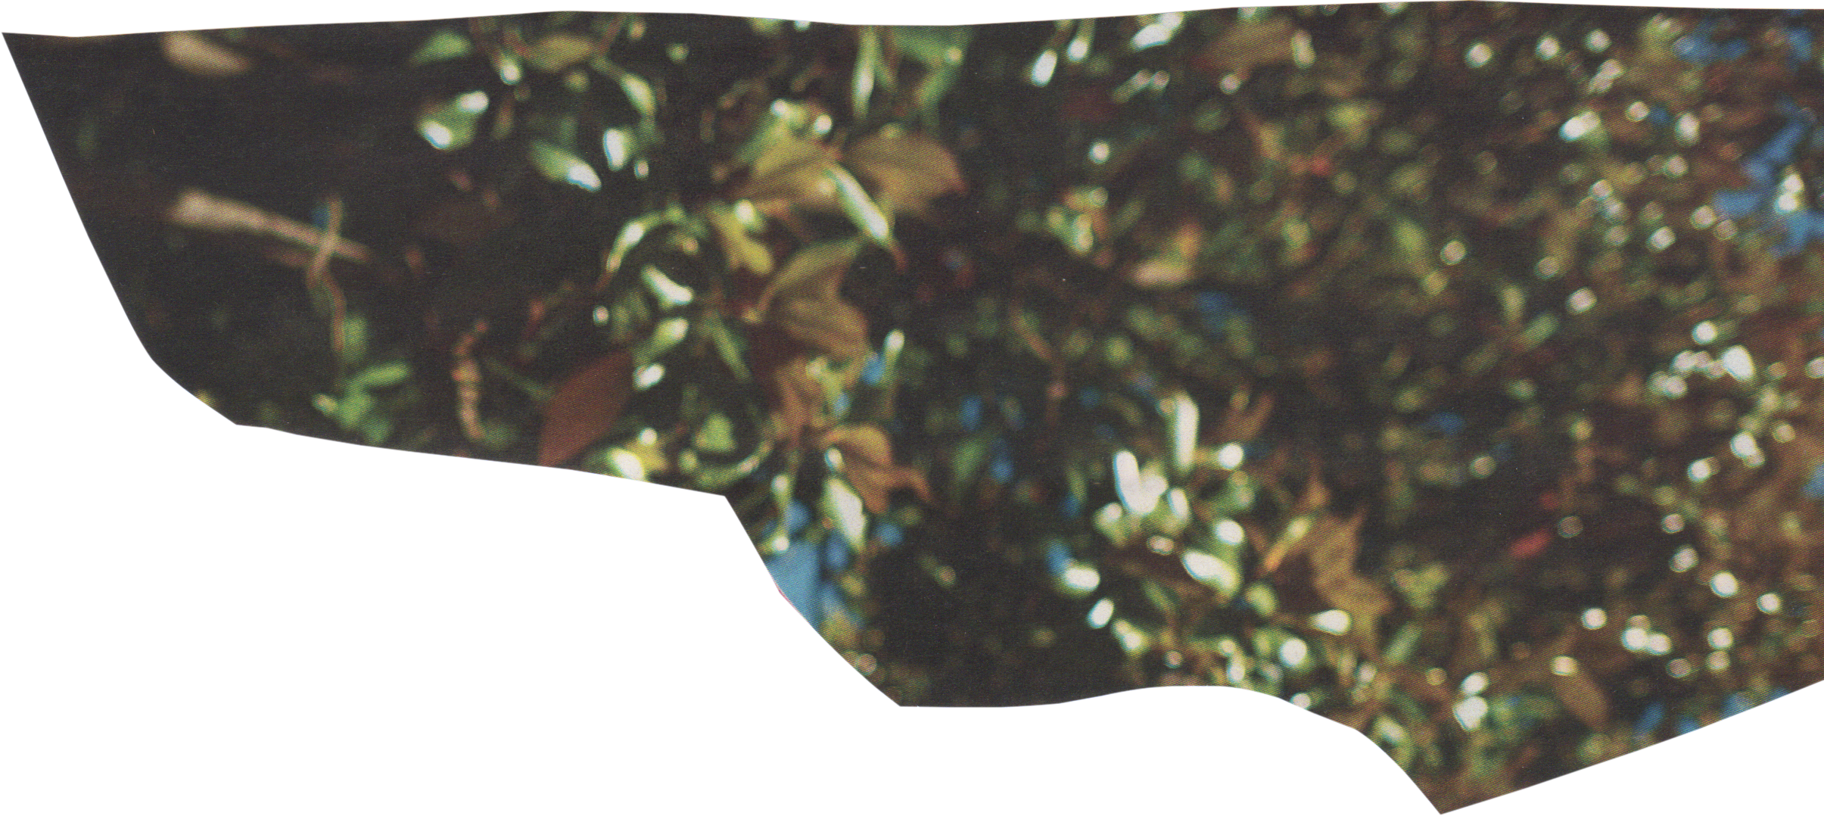





anca@maibine.eu
WWW.MAIBINE.EU
www.incuib.ro
Mai Bine
mai.bine
c.u.i.b
redu.org.ro
mai.bine
LaCUIB
redu.org

